Slide 1
ADO.NET
.NET Data Access and Manipulation

Slide 2
Overview
What is ADO.NET?
Disconnected vs. connected data access models
ADO.NET Architecture
ADO.NET Core Objects
Steps of Data Access
Advanced Techniques and UI Tools

Slide 3
What is ADO.NET?
A data-access technology that enables applications to connect to data stores and manipulate data contained in them in various ways
Former version was ADO (ActiveX Data Object)

Slide 4
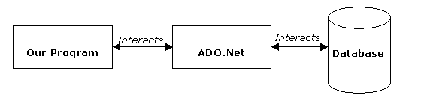
What is ADO.NET?
An object oriented framework that allows you to interact with database systems

Slide 5
Objective of ADO.NET
Support disconnected data architecture,
Tight integration with XML,
Common data representation
Ability to combine data from multiple and varied data sources
Optimized facilities for interacting with a database

Slide 6
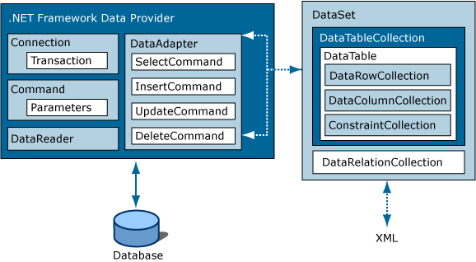
ADO.NET Architecture

Slide 7
ADO.NET Core Objects
Core namespace: System.Data
.NET Framework data providers:
Data Provider | Namespace
SQL Server | System.Data.SqlClient
OLE DB | System.Data.OleDb
ODBC | System.Data.Odbc
Oracle | System.Data.OracleClient

Slide 8
ADO.NET Core Objects
Object | Description
Connection | Establishes a connection to a specific data source. (Base class: DbConnection)
Command | Executes a command against a data source. Exposes Parameters and can execute within the scope of a Transaction from a Connection. (The base class: DbCommand)
DataReader | Reads a forward-only, read-only stream of data from a data source. (Base class: DbDataReader)
DataAdapter | Populates a DataSet and resolves updates with the data source. (Base class: DbDataAdapter)
DataTable | Has a collection of DataRows and DataColumns representing table data, used in disconnected model
DataSet | Represents a cache of data. Consists of a set of DataTables and relations among them

Slide 9
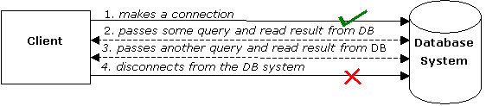
Connected Data Access Model

Slide 10
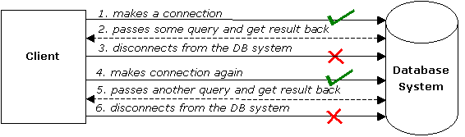
Disconnected Data Access Model

Slide 11
using System;
using System.Data;
using System.Data.SqlClient;
namespace SampleClass
{
class Program
{
static void Main(string[] args)
{
string connStr =
Properties.Settings.Default.connStr;
SqlConnection conn = new SqlConnection(connStr);
string queryString = "SELECT * from titles;";
SqlDataAdapter da = new
SqlDataAdapter(queryString,conn);
DataSet ds = new DataSet();
da.fill(ds);
// Work on the data in memory using
// the DataSet (ds) object
}
}
}
EXAMPLE

Slide 12
Disconnected –
Update, Delete, Insert
SqlDataAdapter da = new SqlDataAdapter();
DataSet ds = new DataSet();
SqlCommandBuilder cmdBuilder = new SqlCommandBuilder(da);
da.Fill(ds);
INITIAL CODE
DataRow dr = ds.Tables[0].Rows[0];
dr.Delete();
da.UpdateCommand = builder.GetUpdateCommand();
da.Update(ds);
DELETE
DataRow dr = ds.Tables[0].Rows[0];
dr["CustomerName"] = "John";
da.UpdateCommand = builder.GetUpdateCommand();
da.Update(ds);
UPDATE
DataRow dr = ds.Tables[0].NewRow();
dr["CustomerName"] = "John";
dr["CustomerSurName"] = "Smith";
ds.Tables[0].Rows.Add(dr);
da.UpdateCommand = builder.GetUpdateCommand();
da.Update(ds);
INSERT

Slide 13
Steps of Data Acces : Connected Environment
Create connection
Create command (select-insert-update-delete)
Open connection
If SELECT -> use a DataReader to fetch data
If UPDATE,DELETE, INSERT -> use command object’s methods
Close connection

Slide 14
static void Main()
{
string connectionString =
Properties.Settings.Default.connStr;
string queryString = "SELECT CategoryID, CategoryName FROM dbo.Categories;";
SqlConnection connection = new SqlConnection(connectionString);
SqlCommand command = new SqlCommand(queryString,connection);
try
{
connection.Open();
SqlDataReader reader = command.ExecuteReader();
while (reader.Read())
{
Console.WriteLine("\t{0}\t{1}“,reader[0],reader[1]);
}
reader.Close();
connection.close();
}
catch (Exception ex)
{
Console.WriteLine(ex.Message);
}
}
EXAMPLE

Slide 15
Connected – Update, Delete, Insert
Command class core methods:
  ExecuteNonQuery : Executes a SQL statement against a connection object
  ExecuteReader: Executes the CommandText against the Connection and returns a DbDataReader
  ExecuteScalar: Executes the query and returns the first column of the first row in the result set returned by the query

Slide 16
Connected – Update, Delete, Insert
string connString = Properties.Settings.Default.connStr;
SqlConnection conn = new SqlConnection(connString);
SqlCommand cmd = new SqlCommand("delete from
Customers" + "where custID=12344", conn);
conn.Open();
cmd.ExecuteNonQuery();
conn.Close();
Can be an update or insert command

Slide 17
Choosing a DataReader or a Dataset
The type of functionality application requires should be considered
Use a dataset to:
  Cache data locally in your application so that you can manipulate it
  Remote data between tiers or from an XML Web service
  Interact with data dynamically such as binding to a Windows Forms control or combining and relating data from multiple sources
  Perform extensive processing on data without requiring an open connection to the data source, which frees the connection to be used by other clients
If readonly data is needed use DataReader to boost performance

Slide 18
Best Practices
Don’t create a new connection string for every code connecting to DB
Use app.config file to keep your connection strings through the application scope
  Right click on project and select properties
  Select settings from the left tabbed menu
  add the connection string to the table and save project, Name field is the name of the string to access at runtime
Accessing settings at runtime:
string connStr = Properties.Settings.Default.connStr;
You can keep any other variable to reach at runtime using this technique

